Slide 1
Hydrant Meter Policy

Slide 2
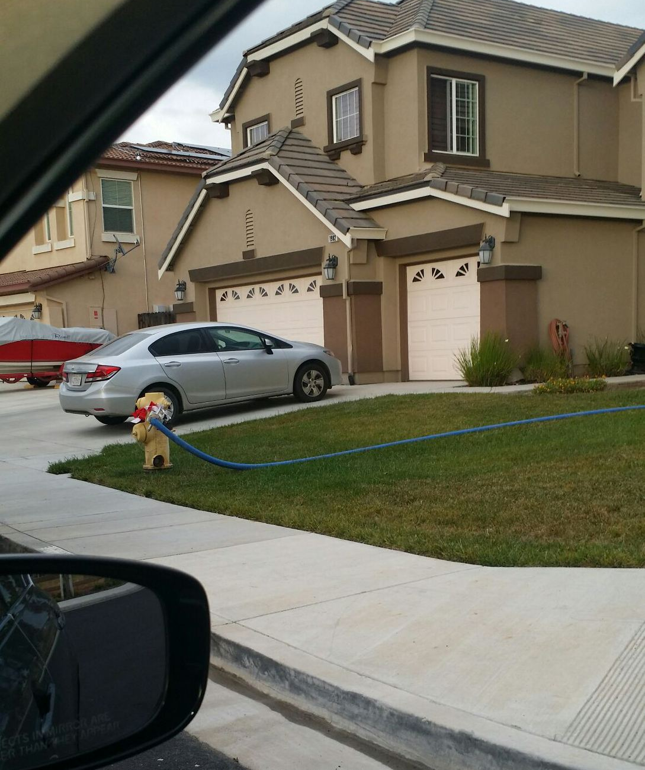
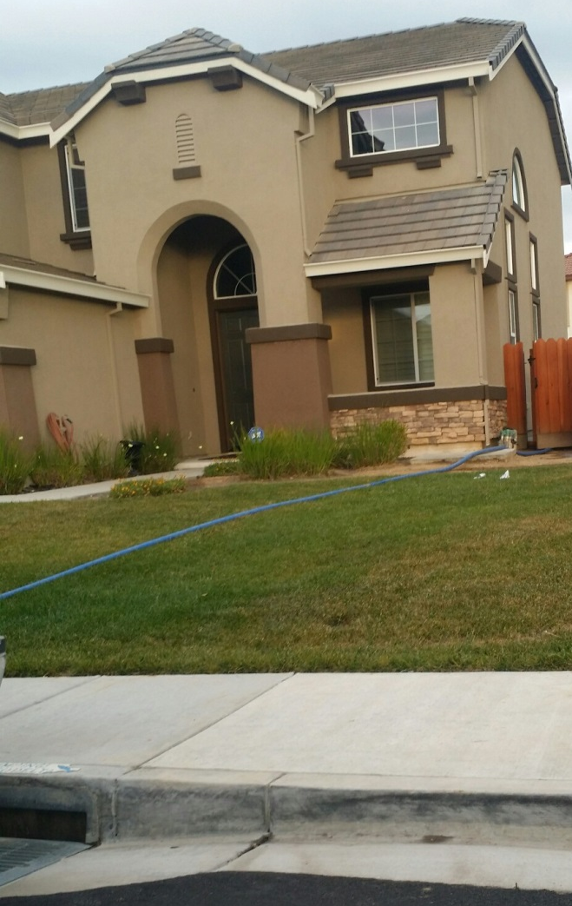
Purpose
To control unauthorized usage of the Town’s fire hydrants, to protect the distribution system’s integrity, quality, fire protection, and provide temporary water needs to the Town of Discovery Bay’s Customers.

Slide 3
INTRODUCTION
Town of Discovery Bay offers two types of hydrant meter applications.
A fixed hydrant meter with attached backflow for vehicles with tanks. This will be located at the Fire Dept. next to the Community Center. This hydrant will be available ONLY during business hours. Business hours are M-F 8:30 a.m. – 5 p.m. A staff member will observe before and after readings of the meter for every visiting customer.
A mobile hydrant meter for uses that require weekend and/or job sites that do not use a tank.
These types are for but not limited to; new construction, new landscaping, pool fillings and maintenance trucks.

Slide 4
Mobile Hydrant Meter
Fixed Hydrant Meter with Backflow

Slide 5
PROGRAM CRITERIA
Fixed Hydrant Meter.
Customer must complete application providing name, business name, business and billing address and purpose of fillings.
A signed copy of completed application must be present during all fill ups.
Mobile Hydrant Meter Rental.
Customer must complete application providing name, business, business and billing address and purpose of fillings.
Renter must provide deposit in check form to the Town of Discovery Bay.
6 month rental only. If not returned, deposit will be forfeited.
Tanks need to be inspected for proper air gap protection.

Slide 6
APPLICATION / RENTAL PROCESS
If renter meets the above-established criteria for use, an application shall be submitted to the town for approval. The application is available at District office 1800 Willow Lake Rd.
The application contains additional information:
Intended use of hydrant water.
Service address of rental hydrant.
Estimated time of hydrant rental.
…...

Slide 7
APPLICATION / RENTAL PROCESS CONT.
Applicant/Renter must take following steps to use or rent hydrant meter.
Fill out application.
If meter is used in conjunction of a tank, the tank needs to be inspected by a qualified Town employee to determine if proper air gap protection is being used.
Place deposit for hydrant meter.
Once all these steps are completed the renter will receive a hydrant meter and a copy of Hydrant Meter Operating Instructions. It is imperative these instructions are given to the personnel using the hydrant meter and that they are followed explicitly. Improper use of both the meter and water hydrant can cause water quality problems in the system and potential confiscation of the hydrant meter.

Slide 8
DEPOSIT, RENTAL, BILLING & PENALTIES
The deposit, fees and penalties apply to fixed and rental of hydrant meters.
Application fee
Deposit for meter rental.
Monthly billings for water usages will occur.
Meter readings once a month or a late fee will apply.
Water usage fee shall apply in accordance with the current water rates.
Deductions from deposit will be placed on misuse, damaged or lost hydrant meters up to the full deposit.
At the time meter is returned, Town staff will:
Take final reading of rental meter and inspect the meter for damages.
Final bill will be issued and mailed to the customer for payment.

Slide 9
Water Meter Rental Fees and Fines
Fixed Hydrant Meter Fees
$25.00 Application Fee
$55.00 Annual Meter Depreciation Fee
Monthly payment for water use
Mobile Hydrant Meter Fees
$25.00 Application Fee
$500.00 Meter Deposit (payable by check)
Monthly Payment for water usage
$20.00 Late Fee will be added if customer does not allow Town staff to read the meter.

Slide 10
Illegal Tap into Fire Hydrant Fines
First offence Warning, Education of our Town’s policy and a $100 fine
Second offence $250 fine
Third offence $500 fine
Thereafter; $1,000 fine for every future offence

Slide 11
Damages to Meters
Mobile and Fixed Hydrant Meter Damages
All damages determined by the Town of Discovery Bay charged up to the replacement of the current meter.

