Slide 1

Water Meter Completion Project
August 2016-December 2016 Update

Slide 2
Budget vs. expenses
Budget $3.111M Expenses $247K (8%)
Product 15%
Construction 0%
Construction Contingency 0%
Staffing 23%
Staffing Contingency 0%

Slide 3
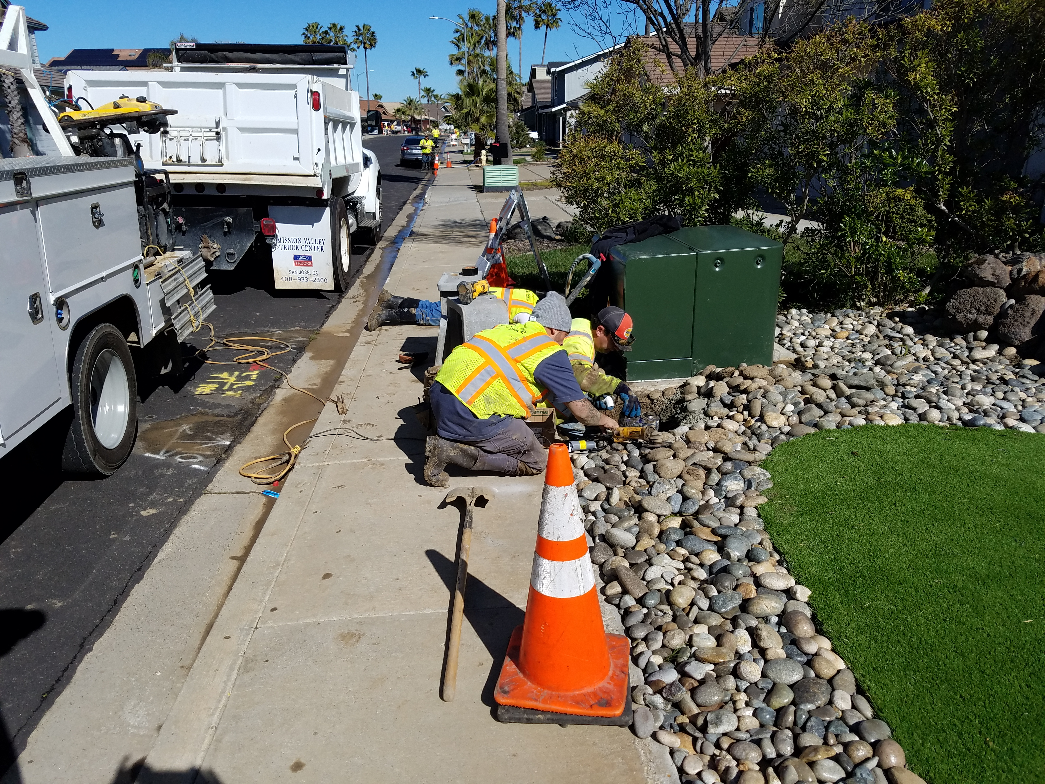
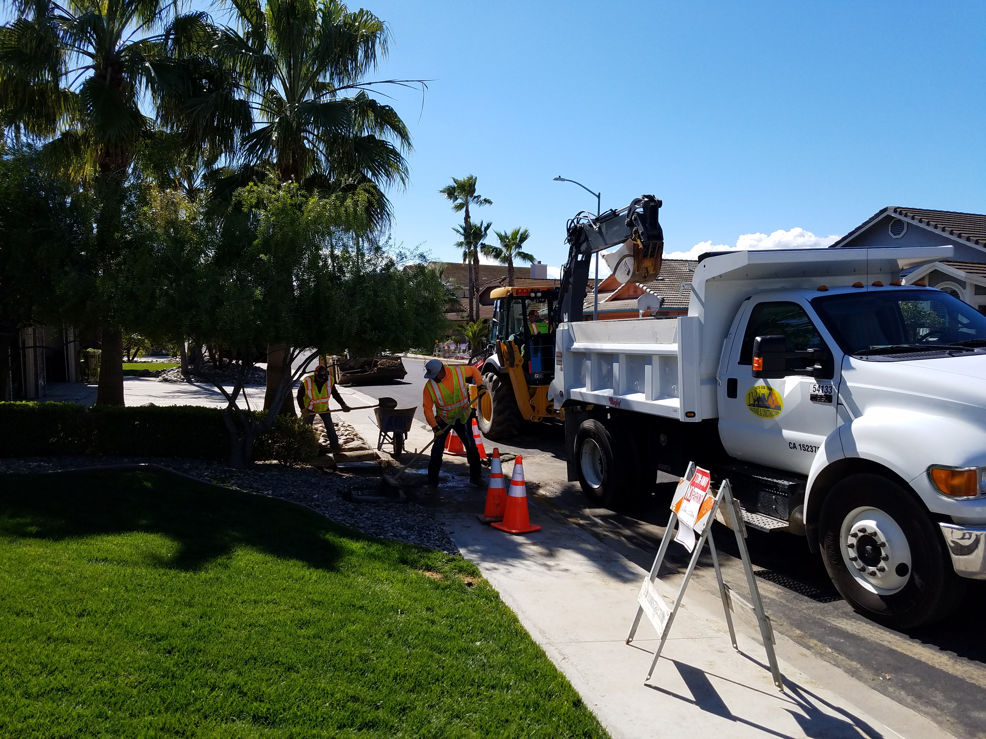
Windward Court Construction

Slide 4
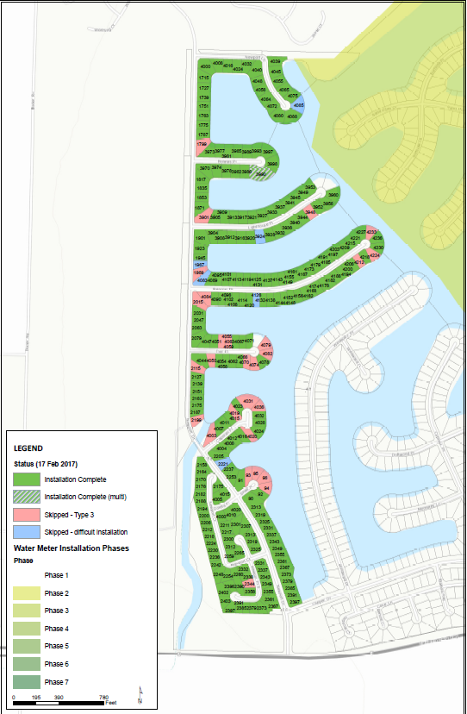
Phase 1
281 installations are Completed as of Friday February 24, 2017

