Slide 1



Town of Discovery Bay
Community Services District
Public Hearing to Review and Adopt the
2010 Urban Water Management Plan
January 6, 2016

Slide 2
Purpose
Present the 2010 UWMP in a public hearing prior to adoption.
Public hearing must include a discussion of:
  Water use reduction goals in accordance with SBX7-7.
  The present and proposed future measures to meet those goals.

Slide 3
Topics
  2010 UWMP Overview
  Water Use Reduction Targets
  Demand Management Measures (i.e. Conservation)
  Other Provisions

Slide 4
  1. 2010 UWMP Overview
State-mandated water supply planning document – (The UWMP Act is a checklist of 60 elements required to be included)
Complies with the UWMP Act, and the Water Conservation Bill of 2009 (SBX7-7).
Directs the long-term planning of water resources (focus is on water source, not the infrastructure and CIP)
UWMP’s are required for urban water suppliers >3000 connections or >3000 ac-ft/yr.
Consistent statewide format for urban water supply outlook.
Required to be eligible for State grants and funding.

Slide 5
1. 2010 UWMP Overview
Relevant Regulations to the UWMP
Urban Water Management Plant Act
Water Conservation Bill of 2009 (SBX7-7)
20x2020 Water Conservation Plan
Water Supply Assessments (SB 610)
Written Verifications of Water Supply (SB 221)
Water Meters (AB 2572)
DMM Implementation Compliance (AB 1420)
Model Water Efficient Landscape Ordinance (AB 1881)
Contra Costa County General Plan

Slide 6
1. 2010 UWMP Overview
  UWMP Contents
  Plan Preparation
  System Description
  System Demand
  System Supplies
  Water Supply Reliability & Water Shortage Contingency
  Demand Management Measures

Slide 7
1. 2010 UWMP Overview
2010 UWMP
State-mandated planning doc
Consistent format for State to assess statewide issues
Focus on source issues (e.g. groundwater) not infrastructure
Identifies 20-year population growth and supply & demand
Requires conservation goals and Demand Management Measures
Required for state funding/grants
2010 Water Master Plan
Planning doc for water agencies
Focuses on all aspects of reliability in supply and infrastructure (assessment of wells, treatment, equipment modeling, etc.)
10-year CIP to meet future growth
Used for financial planning to set rate structures and annual budgets

Slide 8
1. 2010 UWMP Overview
  Summary of Key Elements of 2010 UWMP
  Targets a 20% reduction by 2020 (SBX7-7)
  Assesses water supply (i.e. Groundwater) during normal, dry and critically dry years
  20 year outlook of supply reliability versus demand
  Evaluate alternative supply opportunities: Transfer Water; Desalinated Water; Recycled Water
  Establish a Drought Planning and a Water Shortage Contingency Plan
  Demand Management Measures (DMM) to meet water conservation targets

Slide 9
  2. Water Use Reduction Target
SBX7-7: TODB baseline and target water use
Baseline: = 261 GPCD
Total water use in the system on a per capita basis over a 10-year base period (2000-2010). Population estimates derive from U.S. Census. Water
2020 Target = 209 GPCD
Four methods are allowed to set the target. The method with least impact is the straight 20% of the Baseline.
2015 Interim Target = 235 GPCD
Average of 2010 Baseline and 2020 Target.

Slide 10
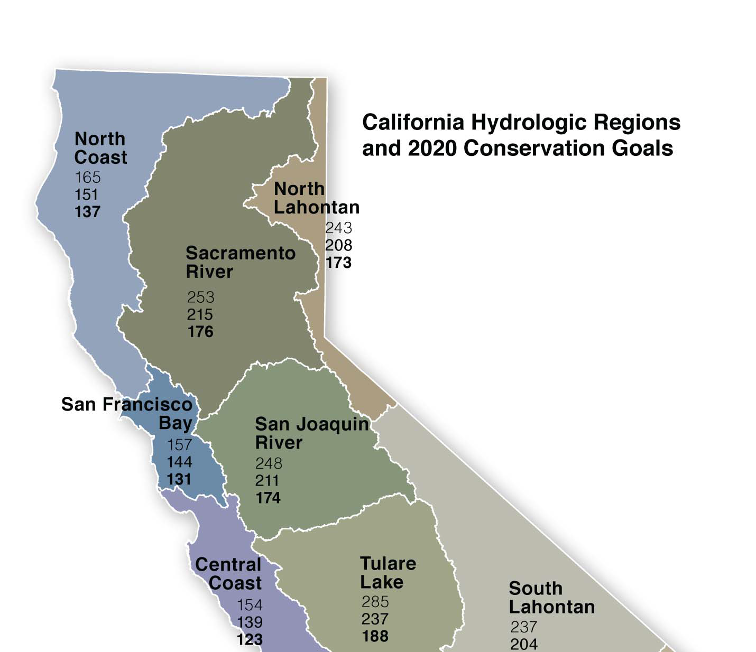
  2. Water Use Reduction Target
Regional Targets
San Joaquin River Region
Baseline
248 GPCD
2015 Interim
211 GPCD
2020 Goal
174 GPCD

Slide 11
  2. Water Use Reduction Target
Comparison with other nearby agencies
Nearby Urban Water Suppliers | Target Method | Avg Baseline Population | Baseline GPCD | Target GPCD 2015 | Target GPCD 2020
Town of Discovery Bay | Method 1 | 11,768 | 261 | 235 | 209
Brentwood City of | Method 1 | 41,881 | 235 | 211 | 188
Los Banos, City of | Method 1 | 30,304 | 233 | 210 | 186
Tracy City of | Method 1 | 57,054 | 227 | 204 | 182
Stockton City of | Method 3 | 146,896 | 195 | 180 | 165
Antioch City of | Method 3 | 96,443 | 186 | 175 | 165
California Water - Stockton | Method 3 | 161,432 | 182 | 174 | 165
Diablo Water District | Method 3 | 23,717 | 175 | 166 | 157
SAN JOAQUIN REGIONAL GOALS | N/A | N/A | 248 | 211 | 174

Slide 12
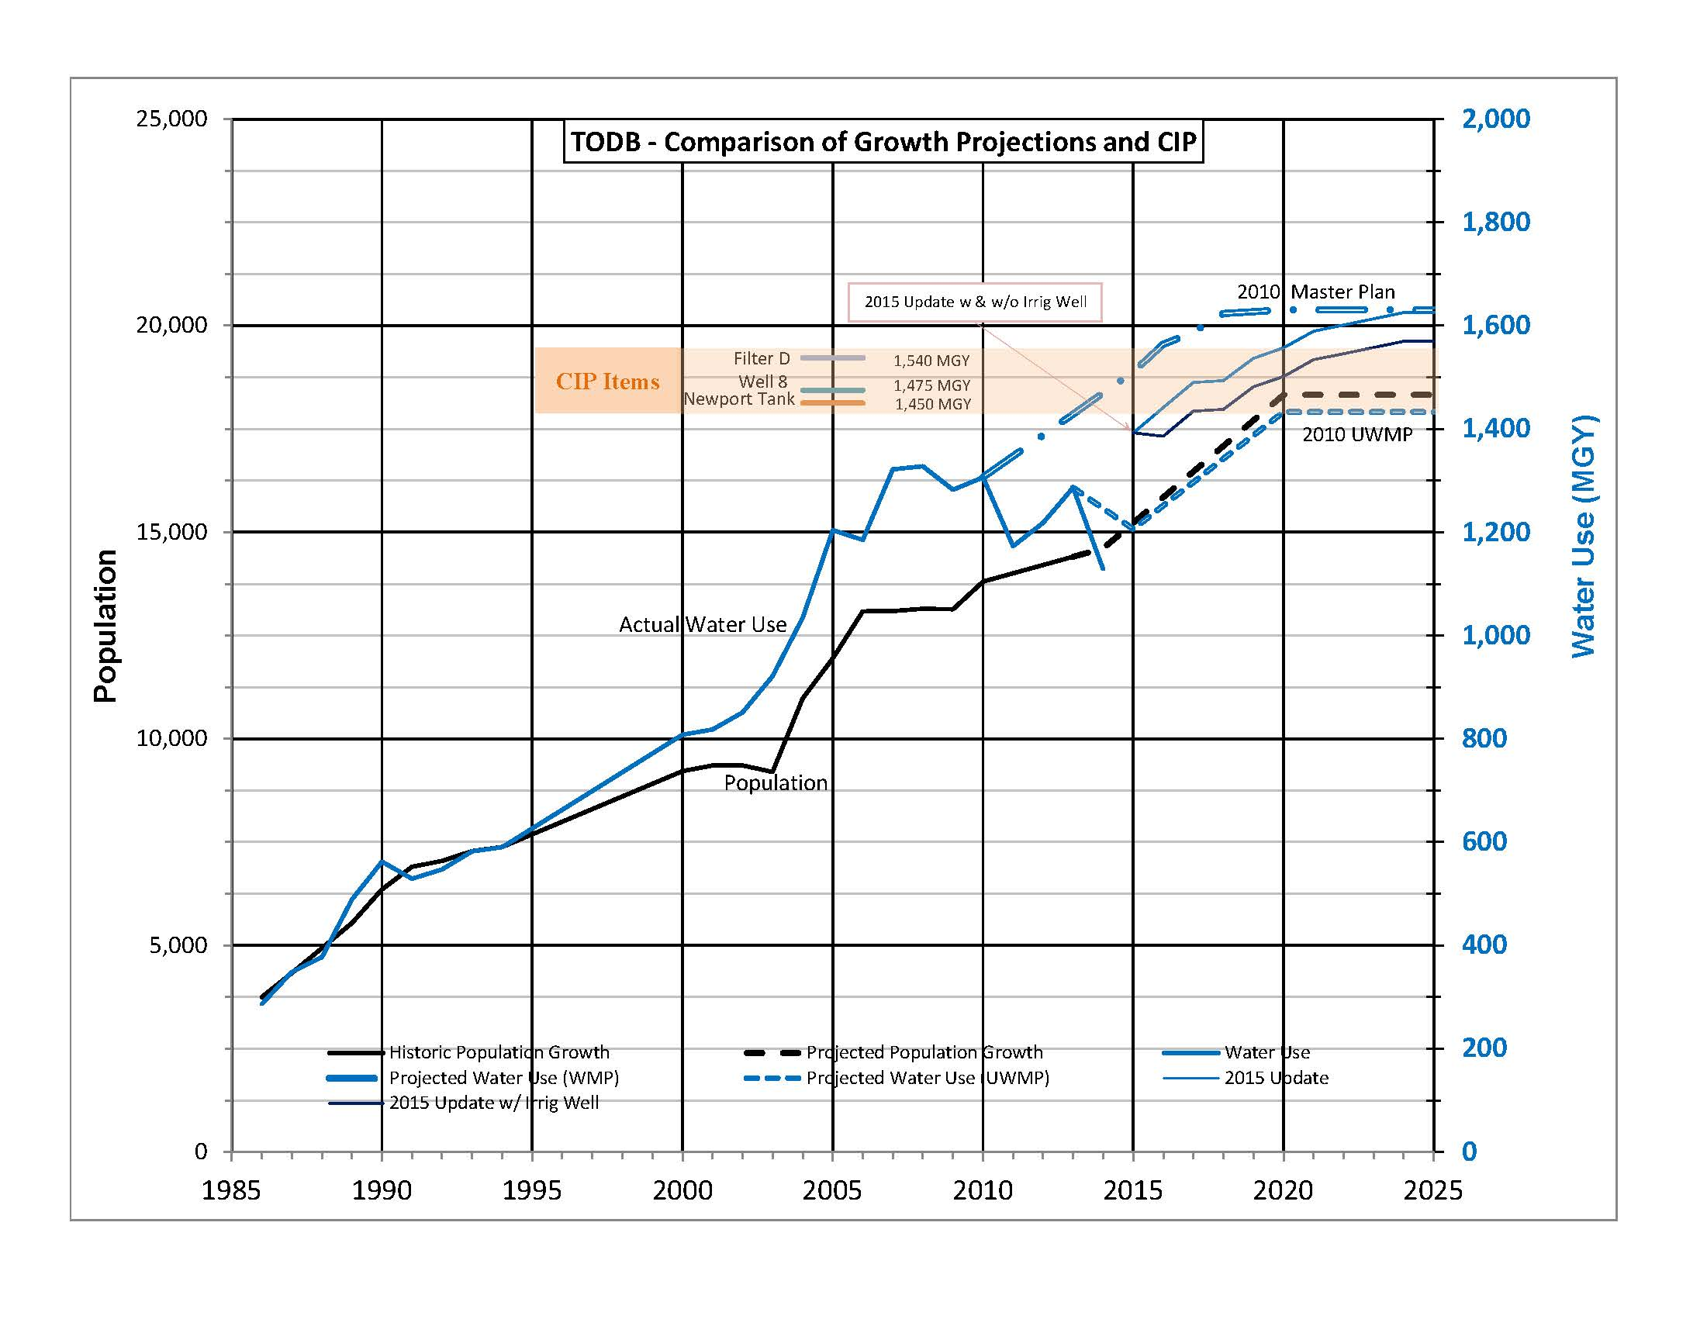
Master Plan
Graph of Population & Production
Population
17% Growth to 2020
37% Growth to 2035
Master Plan
Follows historic
UWMP
20% by 2020
Urban Water
Management Plan

Slide 13
  3. Demand Management Measures
There are 14 DMMs defined in the UWMP Act that must be considered. They were defined by the CUWCC
DMMs that are not planned to be implemented must be supported by a cost-to-benefit analysis.

Slide 14
  3. Demand Management Measures
Water survey programs for single-family residential and multifamily residential customers
Residential plumbing retrofit
System water audits, leak detection, and repair
Metering with commodity rates for all new connections and retrofit of existing connections
Large landscape conservation programs and incentives
High-efficiency washing machine rebate programs
Public information programs
School education programs
Conservation programs for commercial, industrial, and institutional accounts
Wholesale agency programs
Conservation pricing
Water conservation coordinator
Water waste prohibition
Residential ultra-low-flush toilet replacement programs

Slide 15
  3. Demand Management Measures
Foundational DMMs | Schedule / Action | Potential Savings
Metering with commodity rates for all connections | Retrofit existing services 2016-2018 Apply commodity rates | Up to 20% reduction in residential use
Conservation pricing(revenues from volumetric vs. fixed rate) | Uniform/tiered rate structure to be assessed after meters in 2018 | Included in the 20% above
System water audits, leak detection, and repair | Ongoing: visual monitoring and repair. Improve auditing after meters in 2018 | 7-12% water losses estimated Potential savings of 6% based on planned mainline replacements
Public information programs | Ongoing: bill inserts, ads, web links, message board | Un-quantifiable
School education programs | 2016 – ongoing: develop educational materials for local schools | Un-quantifiable
Wholesale agency programs | (N/A – TODB does not have wholesale) | (N/A)
Water conservation coordinator | 2015 – ongoing (i.e. Water/Wastewater Manager) | Un-quantifiable
Water waste prohibition | 2014 – ongoing: ordinances for reducing waste during drought, consider landscape ordinance | 0 – 50% depending on stage of emergency (e.g. current drought is 25%)

Slide 16
  3. Demand Management Measures
Programmatic | Schedule / Action | Potential Savings
Water Survey Programs for SFR and MFR Customers | Ongoing, updates after meters in 2018: provide customers free home audit of leak detection, irrigation timers and appliance upgrades | Up to 10% per audit
Residential Plumbing Retrofit | 2017–2018 (tentative): program would provide free showerheads/faucet aerator kit ($70 value). First assessing effectiveness of other rebate programs | Potential savings of 25 CCF per kit over a 10-yr lifetime. Cost-benefit = $2.5/CCF.
High-efficiency Washing Machine Rebate | 2016-2017: participate in PG&E program for a $150 rebate ($100 from agency + admin fee, $50 from PG&E). Budgeting $15K in rebates to assess effectiveness. | 3,000 GPY per rebate if replacing a in-efficient machine. 10-yr lifecycle cost-benefit = $3/CCF
Residential Ultra-low-flush Toilet Replacement Program | 2016-2017: participate in CUWCC program for a $100 rebate (+admin fee). TODB is budgeting $15K in rebates | 6,500 GPY per rebate if replacing in-efficient toilet. 10-yr cost-benefit = $2.5/CCF
Conservation Programs for CII accounts | 2016-2017: (same as above only $200 rebate for commercial toilet rebate) | 14,000 GPY per rebate if replacing in-efficient toilet. 10-yr cost-benefit = $2/CCF
Large Landscape Conservation Programs and Incentives | 2015–2016: Involve HOAs to implement weather-based controllers | Not quantified

Slide 17
  3. DMMs – Water Use by Sector
TODB Water Use by Sector (typical)
* No Industrial water use

Slide 18
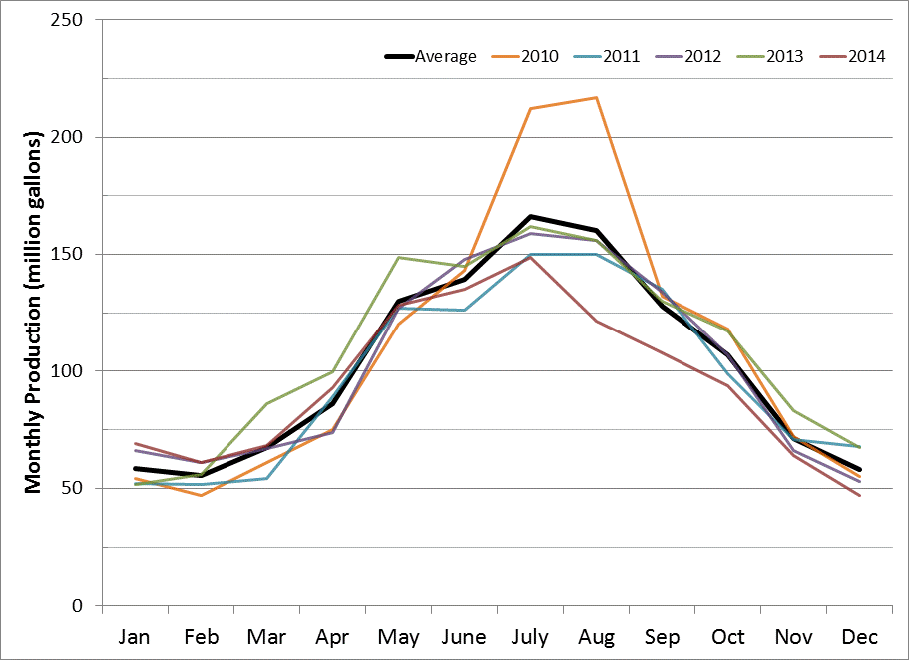
  3. DMMs to Meet 20x2020
Monthly Production Curve
Peak = 470 MGY
Base = 780 MGY

Slide 19
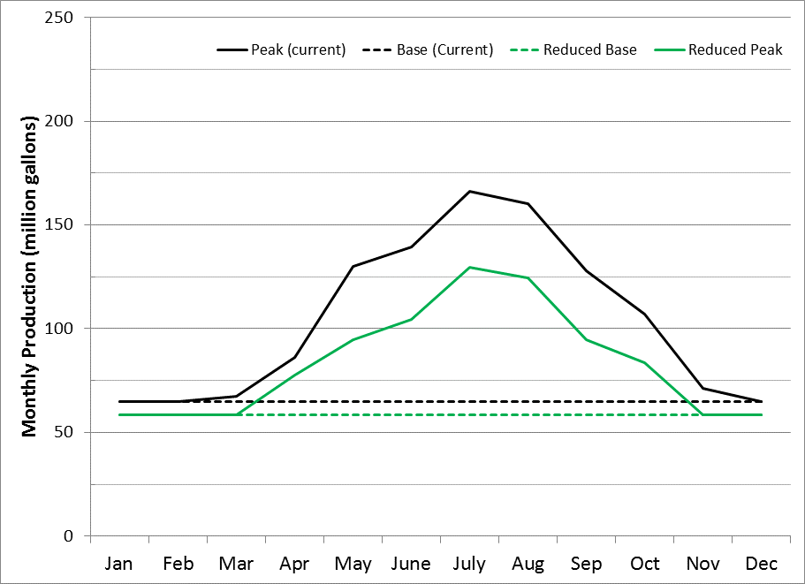
  3. DMMs to meet 20x2020
Monthly Production Curve
Major peak reduction
Peak = 300 MGY
Base = 700 MGY
Minor base reduction

Slide 20
4. Other Provisions (Reliability and Contingencies)
Water Supply Reliability
  San Joaquin Groundwater Basin “Water levels and water quality data indicate stable groundwater conditions at current levels of pumping.” (LSCE 2010 UWMP)
  Groundwater Supplies have been reliable through previous and current drought conditions
  TODB taking action to develop GSP in accordance with Groundwater Management Act of 2014
  Redundant supply wells are in place to meet MDD at all times
Water Shortage Contingency Plan
  Draft Ordinance
  Water rationing in the event of a shortage
  Focuses on catastrophic loss of wells or mandatory state orders.

Slide 21
4. Other items (Opportunities)
Recycled Water Opportunities
  Current Project
    Recent WWTP upgrade that discharge water to be used onsite in lieu of potable water
    Resulted in a 28 MGY water savings (approx. 2% of production savings)
  Potential Projects
    Future WWTP tertiary treatment system → Title 22 recycled water
    Results in 150 MGY of purple pipe potential
    Purple pipe exists but requires a 5 mile transmission main ($4-6 mil)
    Water quality concerns: boron and salinity
  Transfers or Desalination: No plans to participate in transfers or desalination.

Slide 22
  Next Steps
Public Review (today)
Board Adoption
Send adopted UWMP to DWR, Contra Costa County and California State Library
Begin implementation of UWMP and DMMs
Proceed with 2015 UWMP Update

Slide 23
UWMP
Questions?

