Slide 1
Town of Discovery Bay
Fiscal Years 2016-2018 Revenue, Operating and Capital Budget

Slide 2
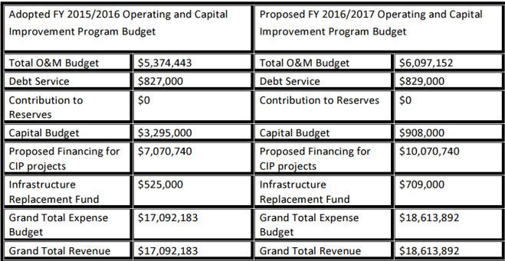
FY 2016-2017 Outlook

Slide 3
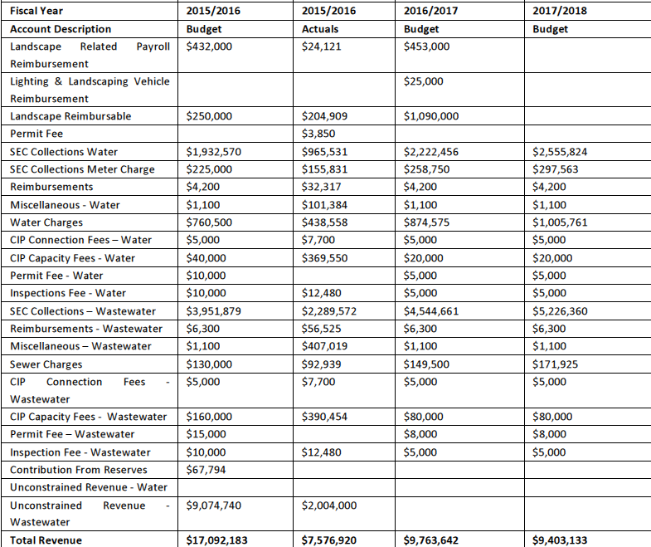
FY 2016-2018 revenue

Slide 4
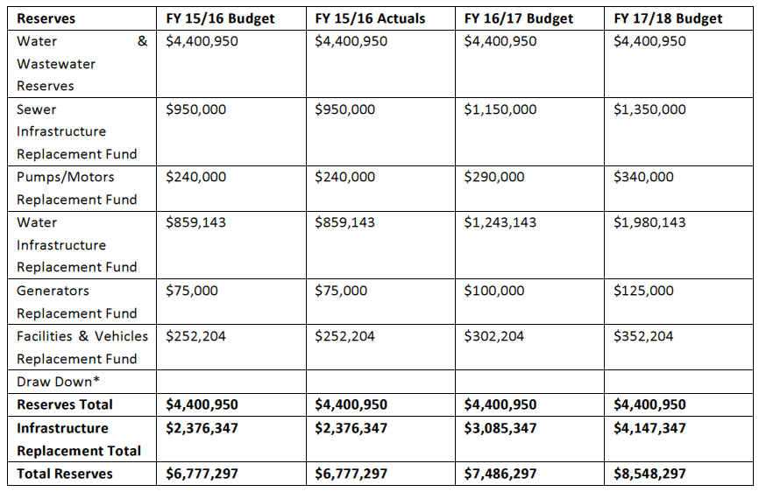
FY 2016-2018 Reserves
Infrastructure replacement reserves increased by $709,000 in FY 2016-2017

Slide 5
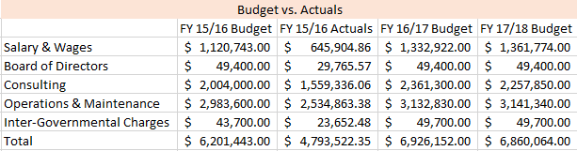
FY 2016-2017 Operations & Maintenance
FY 2016-2017 O&M 10% increase
Additional staff
Insurance (health & facility)
Consulting
Veolia Contract Renewal

Slide 6
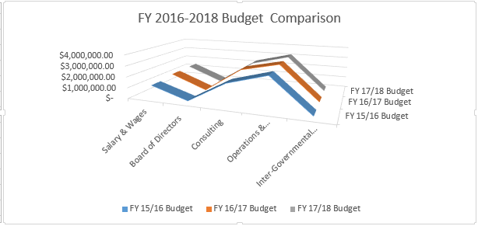
Operations & Maintenance Budget Comparison

Slide 7
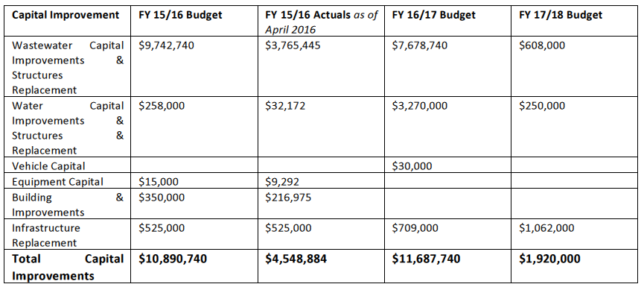
FY 2016-2018 Capital Improvements

Slide 8
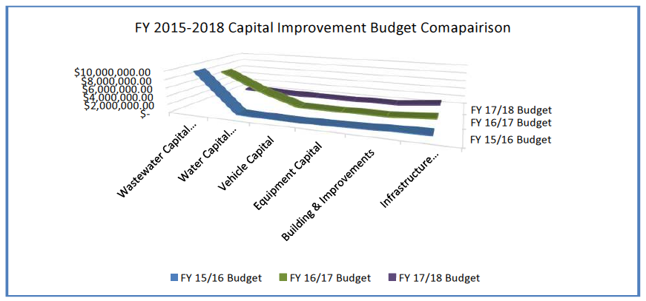
Capital improvements Budget Comparison

Slide 9
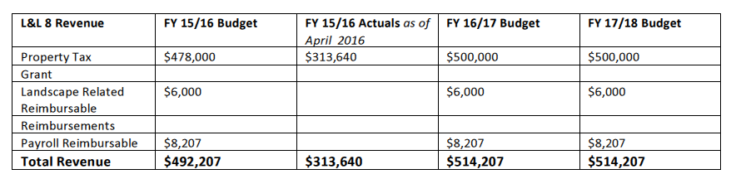
FY 2016-2018 Lighting & Landscaping 8 Revenue

Slide 10
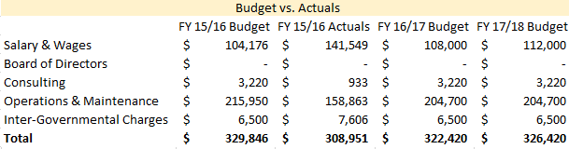
FY 2016-2018 Lighting & Landscaping 8 operations & maintenance

Slide 11
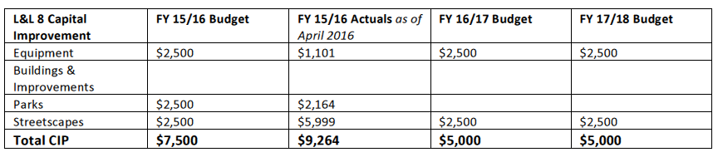
FY 2016-2018 Lighting & Landscaping 8 Capital

Slide 12
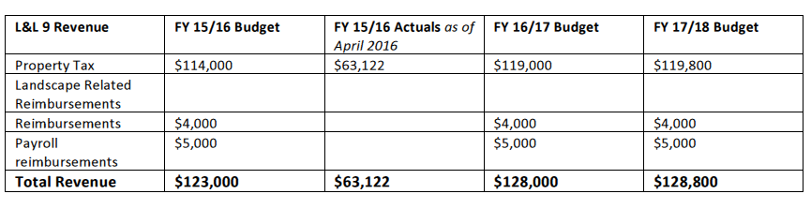
FY 2016-2018 Lighting & Landscaping 9 revenue

Slide 13
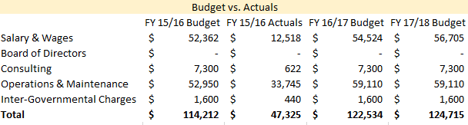
FY 2016-2018 Lighting & Landscaping 9 Operations 7 Maintenance

Slide 14
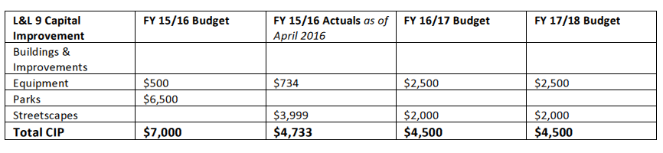
FY 2016-2018 Lighting & Landscaping 9 Capital Improvement

Slide 15
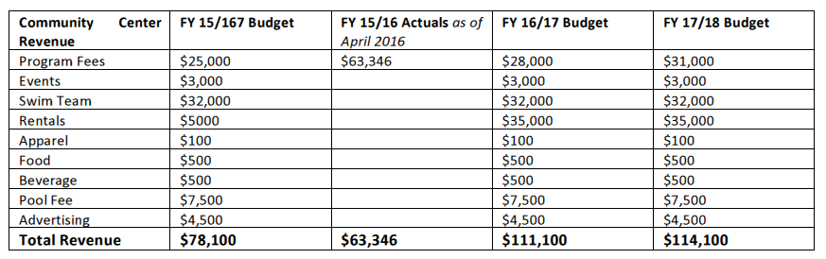
FY 2016-2018 Recreation Revenue

Slide 16
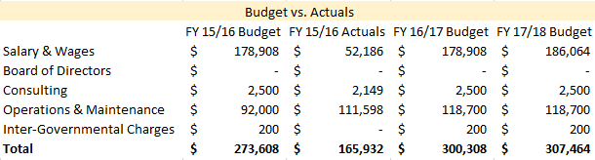
FY 2016-2018 Recreation Operations & Maintenance

Slide 17
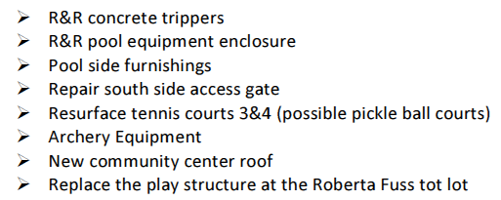
FY 2016-2018 Recreation Capital Improvement
There are no planed Capital Improvement items budgeted, however there are planed project utilizing the once time revenue from PG&E dewatering project.

