Slide 1
Compliance Evaluation Inspection and Notice of Violation
Town of Discovery Bay
Community Services District Wastewater Treatment Plant
HERWIT
ENGINEERING
ORDER No. R5-2014-0073, NPDES No. CA0078590

Slide 2
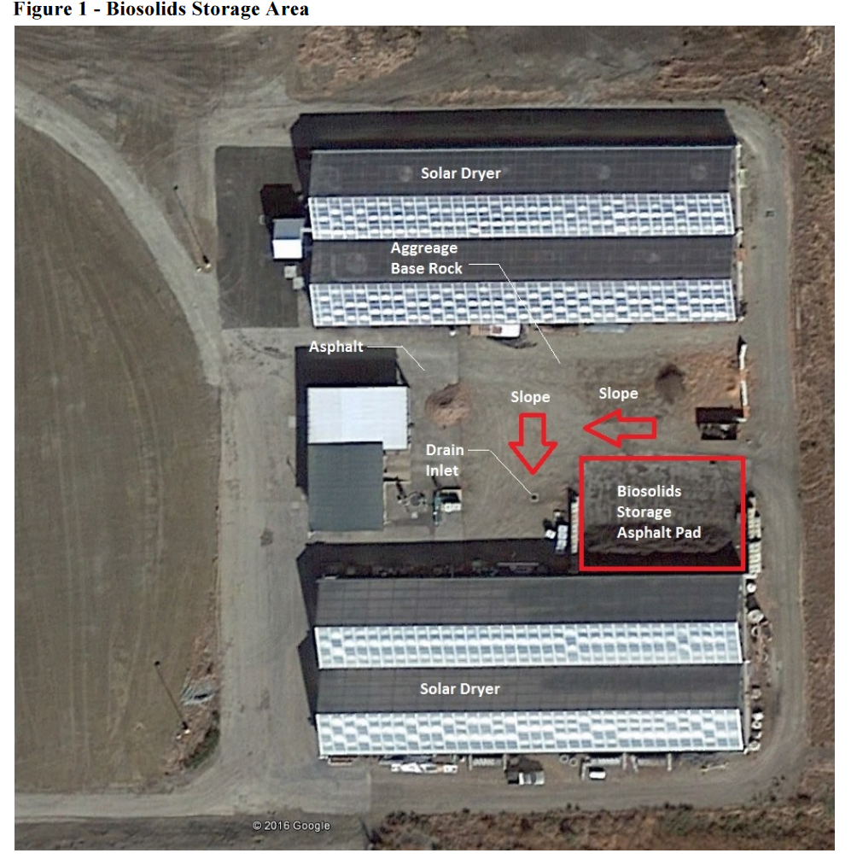

Slide 3
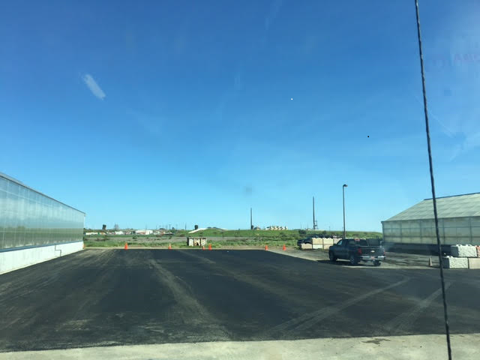

Slide 4
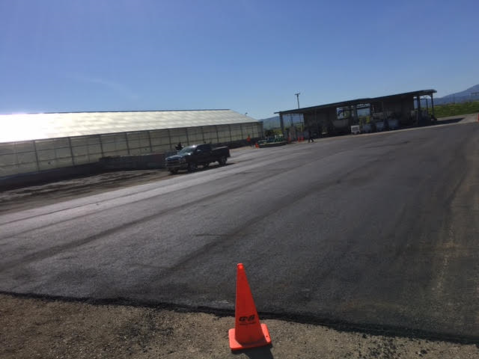

Slide 5
